Slide 1
現代密碼學 Contemporary Cryptography

Slide 2
Course Information
Instructor: 左瑞麟 (Raylin Tso)
Email: raylin@cs.nccu.edu.tw
Office: 大仁樓200314
Office Hours: By appointment
Teaching Assistant: TBA
Laboratory:大仁樓200304
Office hours: By appointment
Web site:
http://www.cs.nccu.edu.tw/~raylin/UndergraduateCourse/ComtenporaryCryptography/Spring2011/CC2011.htm

Slide 3
Course Goals
理解資訊安全的重要性
對密碼理論及演算法有初步的理解
對網路安全及密碼在網路安全上的應用有初步的認識

Slide 4
Topics
Information Security
Classical Cryptography
Shift Cipher
Substitution Cipher
Vigenere Cipher
One Time Pad
Enigma

Slide 5
Topics
Symmetric key cryptography
DES, AES
Basic Mathematics (Discrete Math)
Public key cryptography
RSA
Key distribution
Digital Signature
Applications
PKI, PGP
Quantum Cryptography

Slide 6
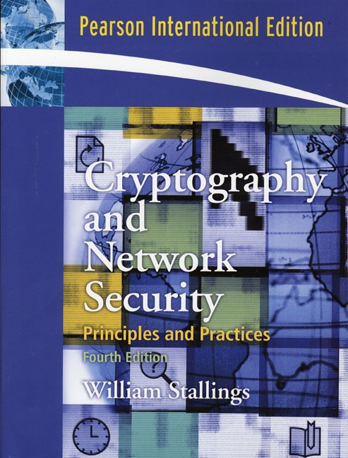
Text Book
Cryptography and Network
Security: Principles and
Practices,
Fourth Edition
William Stallings
Pearson Education

Slide 7
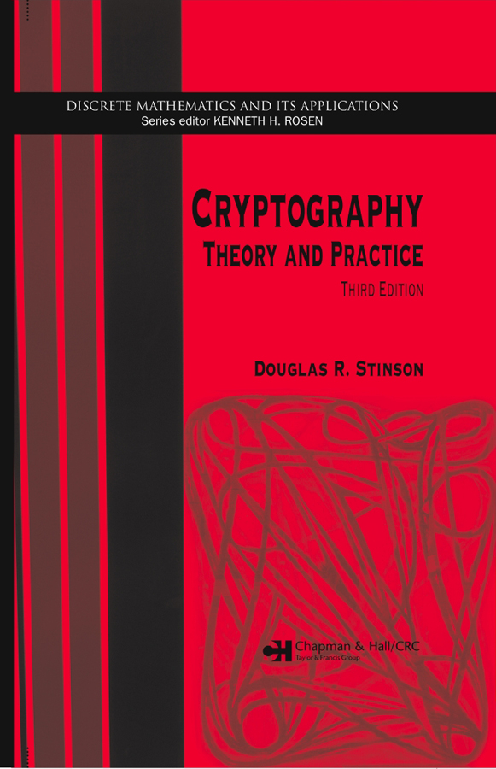
Text Book
Cryptography:
Theory and Practice,
Third Edition
Douglas R. Stinson
CRC Press

Slide 8
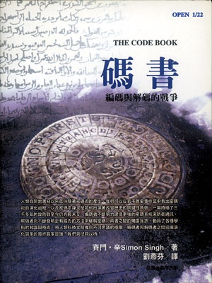
Cryptographic Fiction
碼書：編碼與解碼的戰爭
（The Code Book:
The Science of Secrecy from
Ancient Egypt to
Quantum Cryptography）
Author: Simon Singh (劉燕芬譯)
出版社：台灣商務（2000）
(物理知識)

Slide 9
Grading
Test and Participation (20%)
Midterm (30%)
Final Exam (30%)
Term Project (20%)

